Slide 1
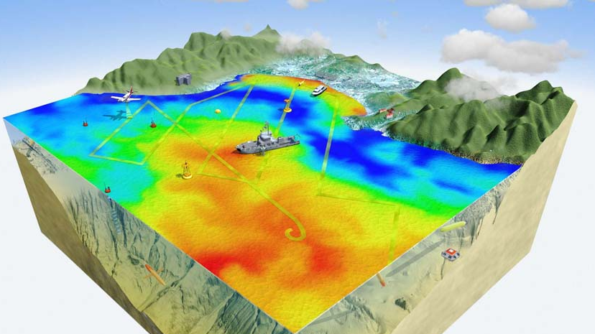
Autonomy at the surface
Robotics in oceanography
Source: http://www.mbari.org/canon/AOSNdefault.htm

Slide 2
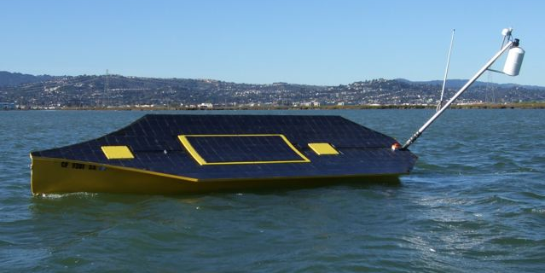
Hardware
Hardware
Software
Theory
Applications
Future work
Research topics

Slide 3
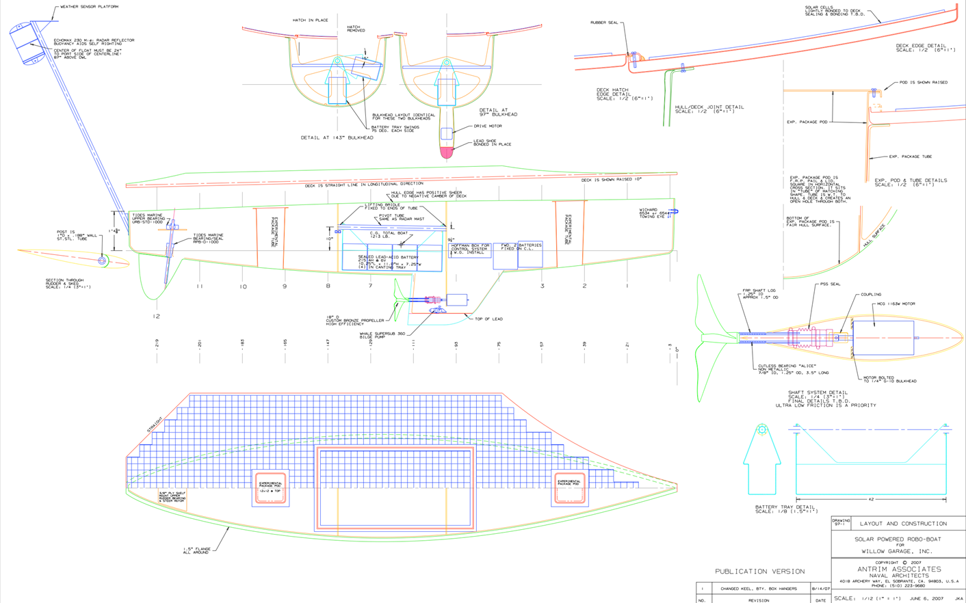
Overview
Notes:
Boat overview:
20’ long
Bright yellow
100’ of surface area
Sits on a trailer out behind this building

Slide 4
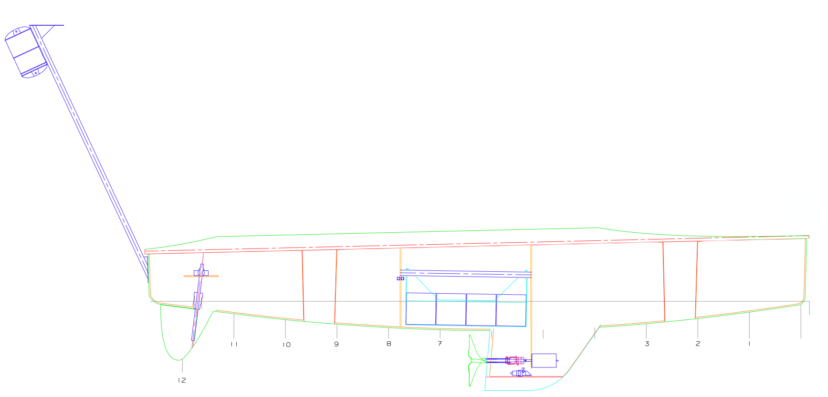
Power
6 batteries for 48V rail
1kW solar input
Shore charging
Notes:
Boat has 2 24V battery banks: a 4x6 and 2x12
Allows 24-hours of continuous operation
Only half in use currently
Running a single 24V rail
Eventually going to move to a single 48V rail
Solar power had been onboard but was removed during vehicle maintenance. Will be replaced and have enough space for 1kW of peak solar input.
We do have shore charging, which is fine for now, and that charges 4 separate 12V banks and runs off 120V.

Slide 5
Actuators
1hp main propeller motor
Max speed 4 m/s
Geared stepper on the rudder
200lb of ballast
Notes:
3 main actuators:
Propeller
peak 1hp motor run at low power
Expected maximum vehicle speed is 4 m/s
Rudder
Large geared stepper motor
Ballast
The 4 6V batteries are mounted in a tray within the vehicle and can rotate providing 200lb of mobile ballast. Large gearing and a wormdrive transmission keeps the ballast stationary once positioned.

Slide 6
Payload
Fore and aft sensor payload bays
~4ft³ volume
Access to air and water
Notes:
Vehicle designed as a sensor platform
Two sensor pods: fore and aft
Both are 1ft² holes that run through the entirety of the hull provided air and water access.
Designed to hold a complete pod so that the exchange of sensor payloads is very fast
A total of 4 cubic feet of space. We already have a test sensor payload of a CTD – conductivity (salinity), temperature, and depth sensor that fits perfectly in the fore sensor bay.

Slide 7
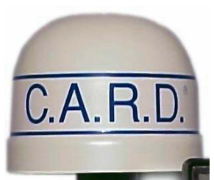
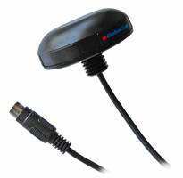
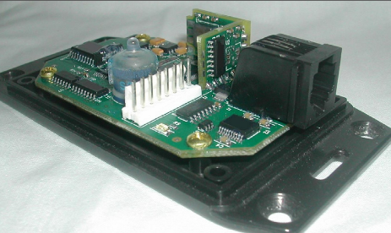
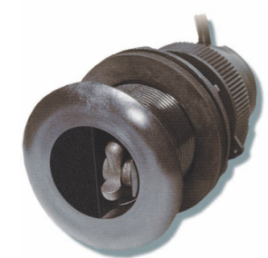
Sensors
Notes:
Sensors
Triducer on the hull in the bow: Water speed/temp/depth. Less accurate than the CTD sensor payload.
GPS on the deck of the bow
C.A.R.D. - Passive radar mounted on the mast at the stern
Mounting room for a wind velocity sensor
2-axis Accel/mag/gyro mounter bow-side of the fore sensor pod

Slide 8
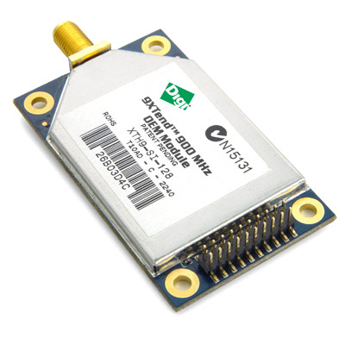
Communications
Xtend radio
1W/64km range
115200baud TX/RX
Source: http://digi.com
Notes:
bi-directional Xtend radio.
900MHz at 1W peak for a line-of-sight range of 64km (double the diameter of Monterey Bay)
Running at 115200 baud we can transmit almost the entire boat state every 100th/s.

Slide 9
Software
Hardware
Software
Theory
Applications
Future work
Research topics
Notes:
And now I’ll talk about the relevant software: first the development toolchain, the operational software

Slide 10
Toolchain
Simulink
Generated C
Program file
Custom C
Notes:
Main development occurs within Simulink
For control algorithms, high-level code
Complemented by low-level C code (through a C-Function Call block)
On-chip peripheral configuration
Sensor drivers
Actuator drivers
Turns into C-code which is compiled with Microchip’s C30 compiler for the PIC processors we’re using.

Slide 11
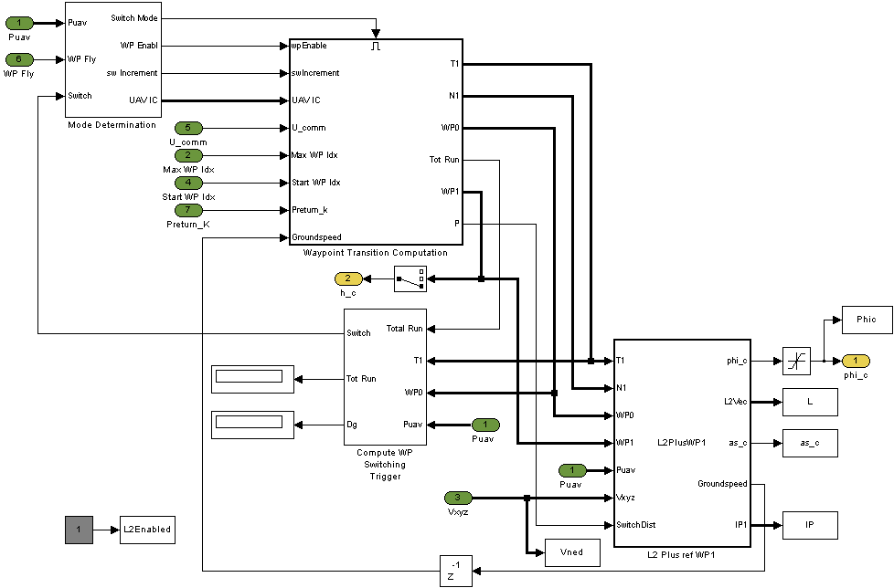
Toolchain continued
Rapid code iteration
Simulink examples lead directly to code
Minimum coding knowledge requirement
Notes:
Simulink is widely used in industry for controls development. It handles much of the low-level details so that controls engineers can focus on the control law itself.
Since our toolchain builds off of Simulink, any controls engineer familiar with it can build and simulate their own control code and then plug it into our system. In essence we’re building a reusable framework.
Rapid code generation is the name of the game.

Slide 12
Development
From simulation in Simulink
To live code in-the-loop
Both with actuators
And without
To live code
Notes:
So development goes as follows:
Simulink simulation
Code execution with facsimile and actual hardware
To production code

Slide 13
Simulation
PC
Notes:
First step is simulation.
Fully contained and executed within Simulink
Logging of data allows for quick debugging
Scripts have been prepared for graphing the result of the run afterwards.
Simulation runs >> real time, 20-30x.

Slide 14
Indoor HIL
Optional
PC
Controller
Board
Propeller
Motor
Rudder
Motor
GS
Notes:
An intermediate step between simulation and live testing
Live code on real control hardware with generated sensor data and actuators that imitate the function of the onboard sensors.
Generally don’t use facsimile actuators as development splits pretty cleanly between actuator output and control theory
Industry standard practice

Slide 15
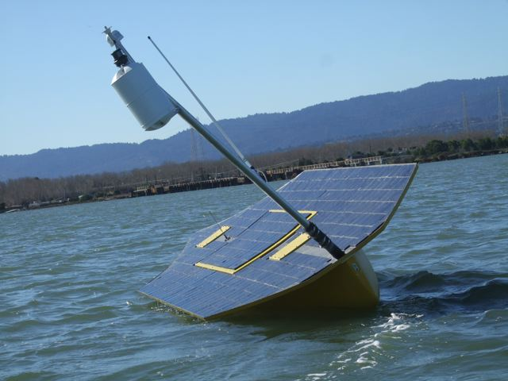
Outdoor HIL
PC
Controller
Board
GS
Notes:
Last step before live testing
Hardware-in-the-loop testing on the real hardware within the vehicle

Slide 16
Live testing
Controller
Board
GS
Notes:
Onboard live-action test. This uses the same controller board used throughout HIL. Removes the PC, but keeps the groundstation operating over a wireless link.

Slide 17
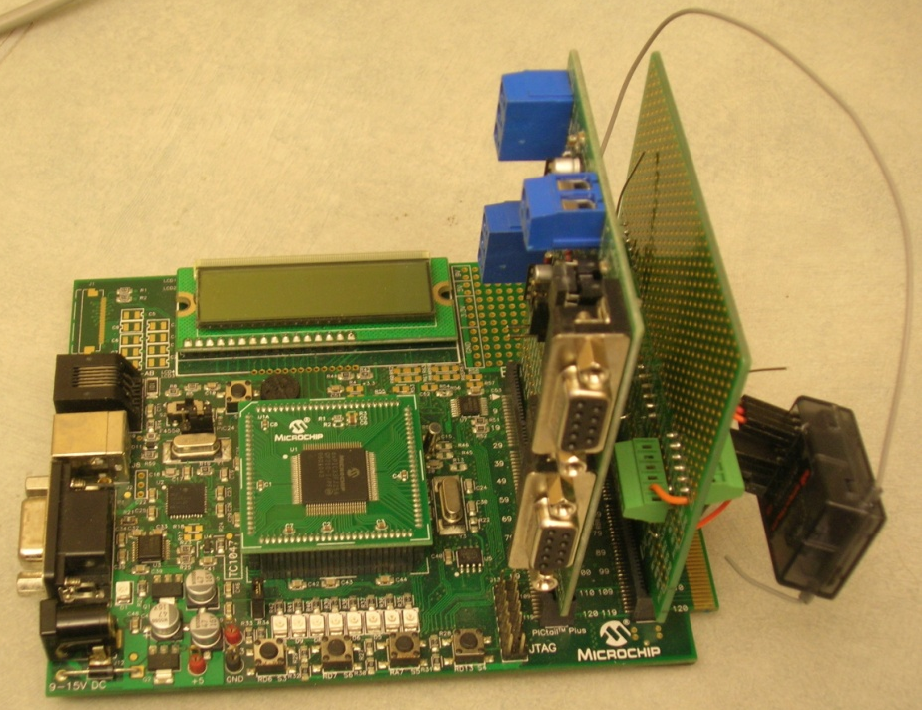
Onboard Control
GPS position
Manual control
Waypoint guidance
Multiple track runs
Notes:
Here is the onboard controller.
Features include:
GPS sensor input
Manual control via RC transceiver
Waypoint guidance with multiple waypoint sets called “Tracks” for testing.

Slide 18
Control software overview
Stepper Controller
HIL In
Sensor Filtering
State Calculation
Waypoint Guidance
HIL Out
GPS
Propeller Controller
Notes:
Software overview of the actual control code running

Slide 19
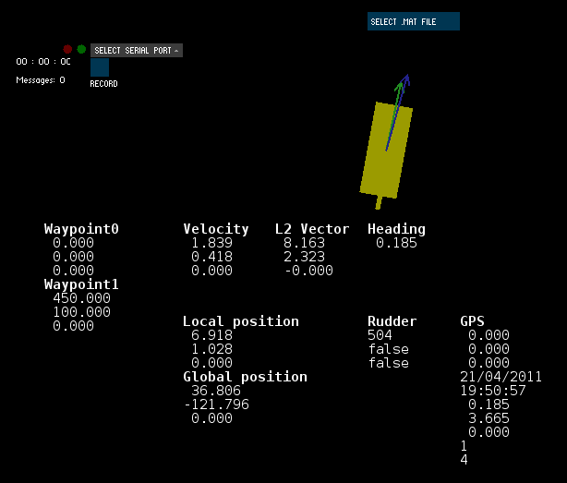
Groundstation
Run on a standard laptop
Live display w/ replay
Matlab export
Wireless link for full state display

Slide 20
Theory
Hardware
Software
Theory
Applications
Future work
Research topics

Slide 21
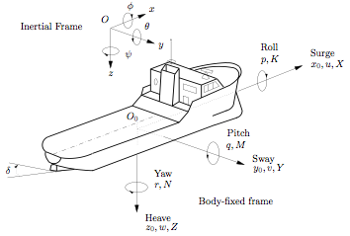
Kinematics
4-DOF model
Roll
Surge
Sway
Yaw
Notes:
A vehicle in 3-space has a standard set of 3 translational forces: Surge, Sway, and Heave and 3 rotational forces: Roll, Pitch, and Yaw. Our model ignores the Heave and Pitch because we’re idealizing a 2D plane for the water surface. This may change going forward, however.

Slide 22
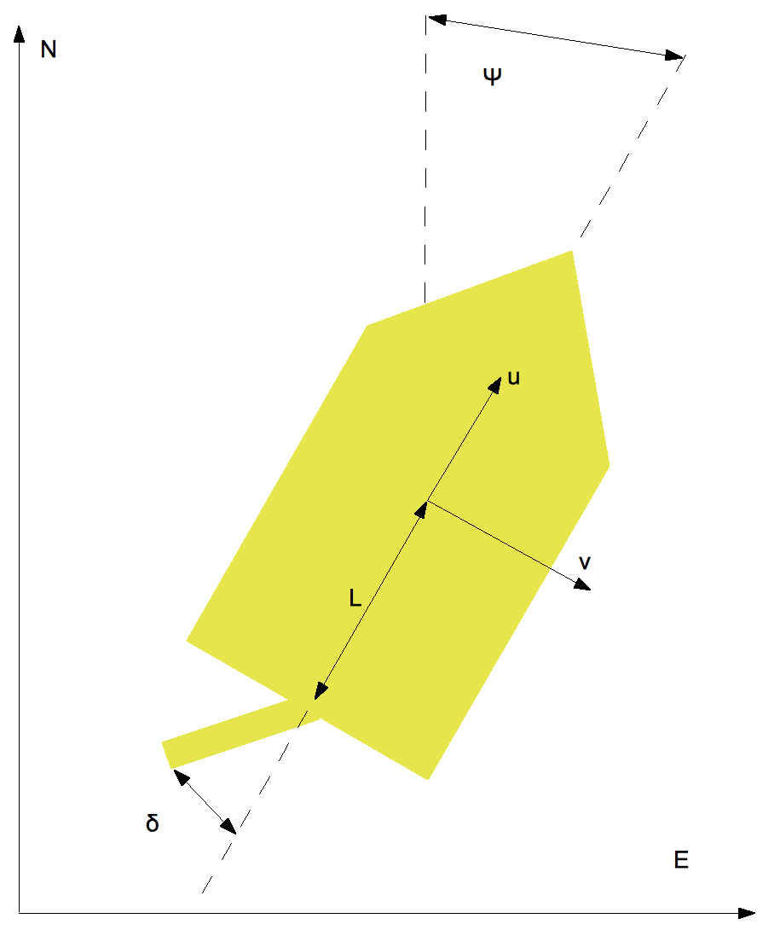
Inverse-bicycle Model
Calculates heading and position delta from the Surge and Sway.
Notes:
The inverse bicycle model provides the basis of our modeling. It’s name is derived from the bicycle model, but this time with the steering mechanism in the rear. It’s a simple function of heading and Surge & Sway for the position. Heading is calculated as a function of rudder angle and Surge.
Now this may be the simplest model that one can design for a boat. It is perfectly fine for our uses, however, as the rest of the system is more important currently. We’ll come back and revisit the plant as we deem appropriate in the future.

Slide 23
Waypoint Control
Manages waypoint tracks
Tracks source and destination
Termination condition is patrol, loop, or hold
Heading and speed control
Speed control dependent on power
Heading main focus
Notes:
Waypoints are managed by a separate waypoint controller. It also manages different “missions” or “waypoint tracks” that are used for testing. These can be switched between remotely via the radio transmitter.
It outputs the next and previous waypoint for the heading controller.
When a track terminates there are three settings: patrol reverses the waypoint ordering to head back along the track continuosly, loop resets to the first waypoint and starts over, and hold sets a holding pattern around the final waypoint and maintains position around it.
The waypoint control feeds into both a speed controller and heading controller. The speed controller is a null controller right now as it just runs at near full-speed along the track. The heading controller is based on the standard L1 line controller.

Slide 24
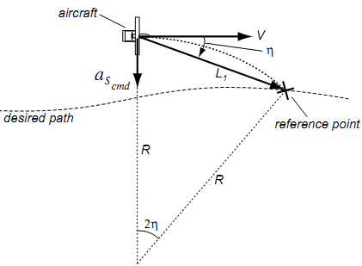
L₁ Control
d
Notes:
L1 control is a heading controller that tracks an intersection on the desired path and controls the heading towards that aim point. The L1 vector has a specified length that is speed-dependent to account for the vehicle dynamics. This model assumes that lateral forces can be generated. This isn’t true for a boat, but can be approximated.
The premise is that once a reference point is chosen along the desired track a semicircle is drawn between those two points with an angle 2n based on the heading error. For the vehicle to hold this trajectory the equation for centripetal force is used, v^2/R. So with the heading This command is then translated to a rudder angle via some extra equations that I won’t address here.

Slide 25
L₂ Control
Extension of L₁
When d > |L₂| use Aerosonde control law
d
Notes:
The L2 controller extended L1 control with Niculescu’s control law for the Aerosonde AUV (first robotic airplane to cross the Atlantic). This control law handles high wind situations very well. I’m not so sure on the details.

Slide 26
L₂₊ Control
When d < |L₂|
d
Notes:
L2 control is a simple extension of this L1 control. It was necessary to handle the case when the L1 vector is too short to intersect the desired path, i.e. when the crosstrack error > L2.
An intersect angle is then chosen, based on speed, to select a new aim point. There is an upper-limit on the down-track distance to this aim point, which is also proportional to the L2 vector. The only edge condition is when that aim point is near a waypoint when the desired path will change as this is relying on straight-line segments. A simple extension that would remove this special case is using Ji-wung’s Bezier curve path planner.

Slide 27
Applications
Hardware
Software
Theory
Applications
Future work
Research topics

Slide 28
Use-cases
Ideally suited to long-term observation tasks
Cheap
Small
Unmanned
Low-maintenance
Remotely manageable

Slide 29
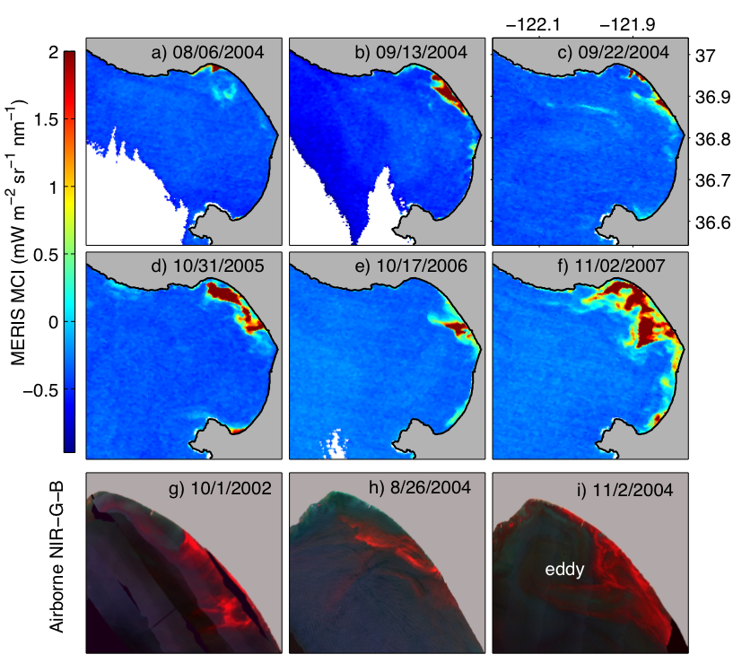
Oceanography
Source: www.mbari.org
Notes:
MBARI very interested in an autonomous surface vessel to study surface effects. This is a general fail-case for the underwater vehicles as they can’t get within the top couple of meters.

Slide 30
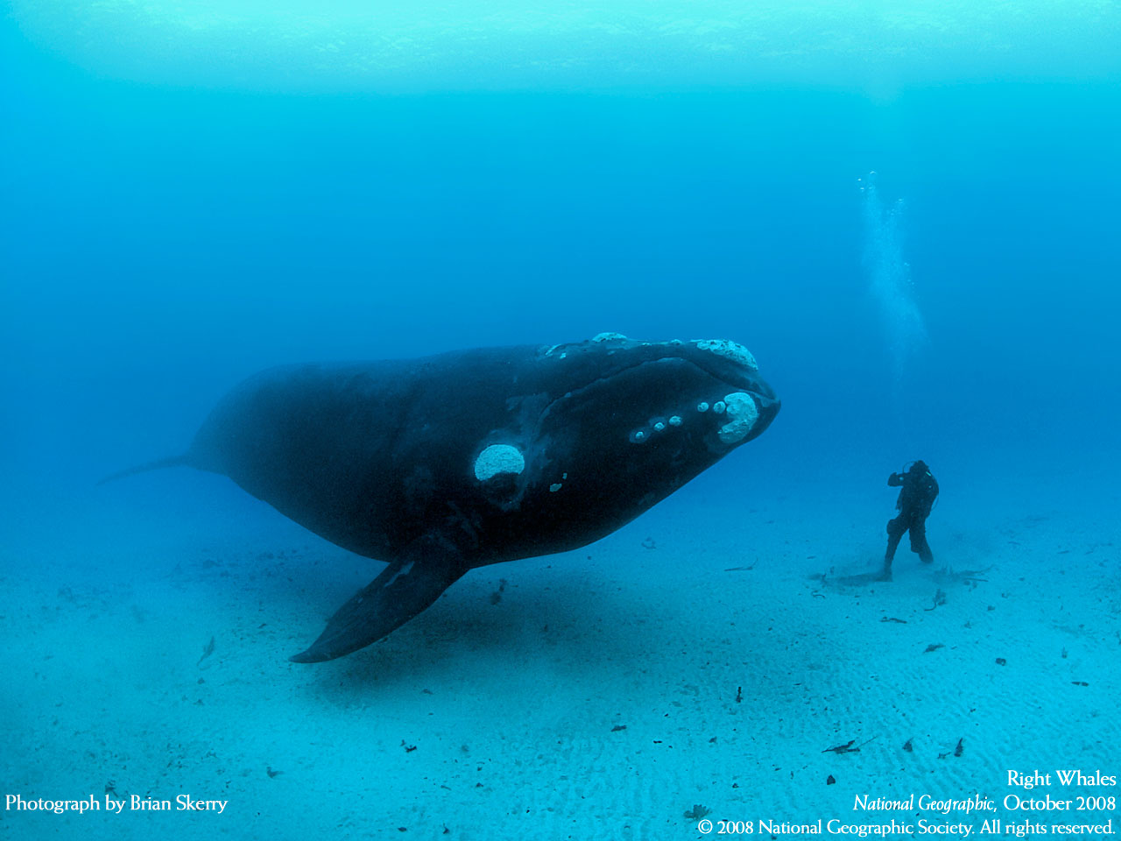
Wildlife observation
Source: http://ngm.nationalgeographic.com/wallpaper/img/2008/10/oct08-19-1280.jpg
Notes:
With the concern of over-fishing and especially over-whaling, observation of these animals is a task ideally suited for automation. As you can see, using SCUBA divers is not an optimal method.

Slide 31
Data collection
Weather monitoring
Near-port traffic monitoring
Tsunami watch
Weather observation
Mapping

Slide 32
Future work
Hardware
Software
Theory
Applications
Future work
Research topics
Notes:
Besides bug hunting and code refactoring?

Slide 33
Moving forward
Improved kinematics
New groundstation
Advanced path planning
Obstacle avoidance
High-level planner
Improved sensors
Notes:
Improved kinematics: An inverse-bicycle model is the lowest-bar we could get away with.
New groundstation: A new groundstation that’s externally supported and somewhat standardized.
Advanced path planning: A recent graduate from our lab, Ji-wung, developed a sophisticated system for path planning and obstacle avoidance based on Bezier curves
Obstacle avoidance: see above
High-level planner: MBARI has been putting work into a planner that would plan at the mission and objective level.
Improved sensors: We’ll need an improved payload to do obstacle avoidance.

Slide 34
Improved kinematics
Based on Fosson 1994
Additional forces
Hydrodynamic (drag, etc.)
External
Propulsion
Control surfaces

Slide 35
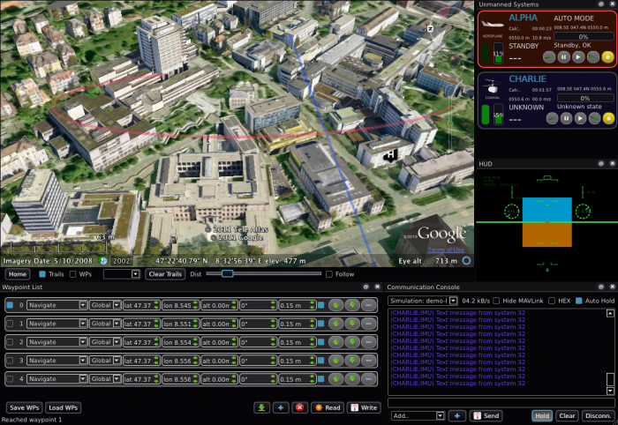
qGroundControl
Source: http://www.qgroundcontrol.org/screenshots
Notes:
qGroundControl is a large open-source project providing groundstation functionality for the diy-drones people. It’s built on the multi-platform Qt toolkit, uses a standardized and extensible MAVlink communication protocol, and integrates mapping (2D and 3D) functionality. Dr. Lizaragga has already started porting the SLUGS autopilot over to rely on qGroundControl and I think he’s got the basic functionality up and running.

Slide 36
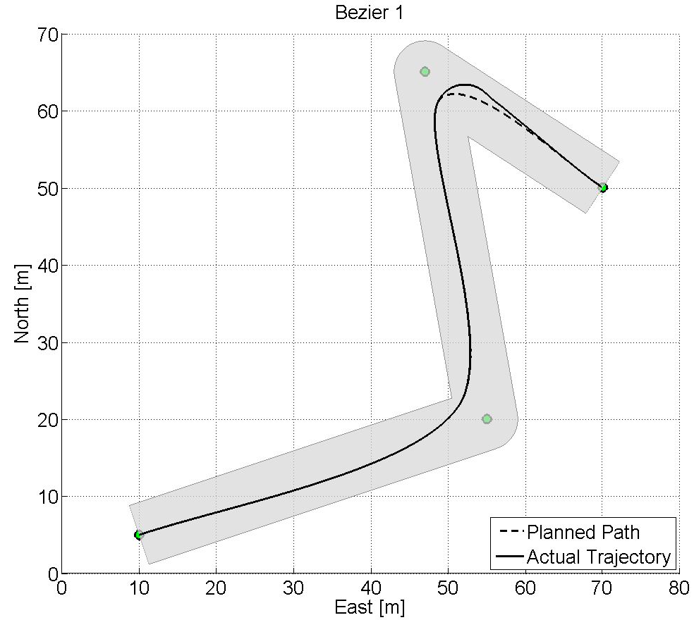
Bézier path planning
Source: Reference 4
Notes:
Rough-overview:
Given a hallway for navigation and the waypoints Ji-wung’s planner can plan for optimal paths. It takes into account the vehicle dynamics such as turn-rate and possible speeds. This can be used to define Bezier curves that include these requirements mathematically.

Slide 37
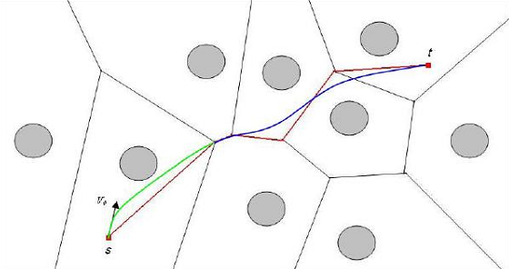
Obstacle avoidance
Source: Reference 3
Notes:
This is a Voronoi diagram made of various obstacles in 2-space. Ji-wung’s obstacle avoidance mechanism relies on the edges to build Bezier curves for the path. It has already been extended to apply to constant-speed moving obstacles and work is underway to further expand it.

Slide 38
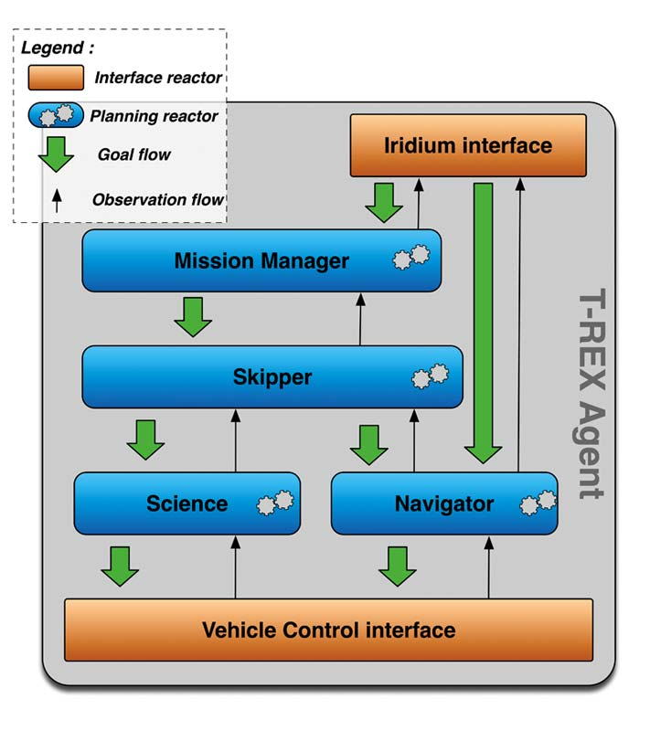
T-REX high-level planner
Source: Reference 1

Slide 39
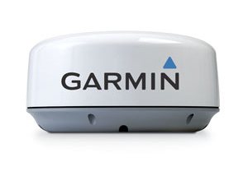
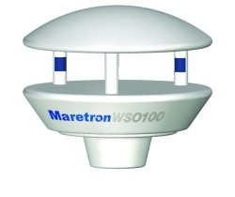
Improved sensors
Active radar
Wind sensor
Radar: Garmin GMR 18 - https://buy.garmin.com/shop/shop.do?cID=151&pID=8050
Wind sensor: Maretron WSO100 - http://www.maretron.com/products/wso100.php

Slide 40
Research topics
Hardware
Software
Theory
Applications
Future work
Research topics

Slide 41
Open research topics
Automated oceanography
Sensor integration with controller
Event detection & response
Dynamic sampling
Mixed traffic control
Nautical rules
Harbor navigation
Multi-vehicle control
Aerial/submerged vehicle cooperation

Slide 42
References
K. Rajan, F. Py, C. McGann, J. Ryan, T. O'Reilly, T. Maughan & B. Roman. “Onboard Adaptive Control of AUVs using Automated Planning and Execution”. International Symposium on Unmanned Untethered Submersible Technology (UUST) August 2009. Durham, NH.
S. Park, J. Deyst, and J. P. How. “A New Nonlinear Guidance Logic for Trajectory Tracking”. In AIAA Guidance, Navigation, and Control Conference and Exhibit, Providence, RI, August 2004. AIAA-2004-4900.
Choi, J., Curry, R., and Elkaim, G., “Obstacle Avoiding Real-Time Trajectory Generation of Omnidirectional Vehicles,” IEEE Conference on Robotics and Automation, ICRA2009, Kobe, Japan, May 12-17, 2009
Choi, J., Curry, R., Elkaim, G., “Smooth Path Generation Based on Bezier Curves for Autonomous Vehicles”, World Congress on Engineering and Computer Science, WCECS 2009, San Francisco, CA, Oct. 20-22, 2009.
Fossen, T. I. (1994). Guidance and Control of Ocean Vehicles. John Wiley and Sons Ltd. ISBN 0-471-94113-1.
M. Niculescu. Lateral Track Control Law for Aerosonde UAV. In 39th AIAA Aerospace Sciences Meeting and Exhibit, Reno, NV, January 2001. A01-16013.

